Slide 1
P. Sci.
Unit 5
Waves
Chapter 17

Slide 2
Waves
A wave is a disturbance that carries energy through matter or space.

Slide 3
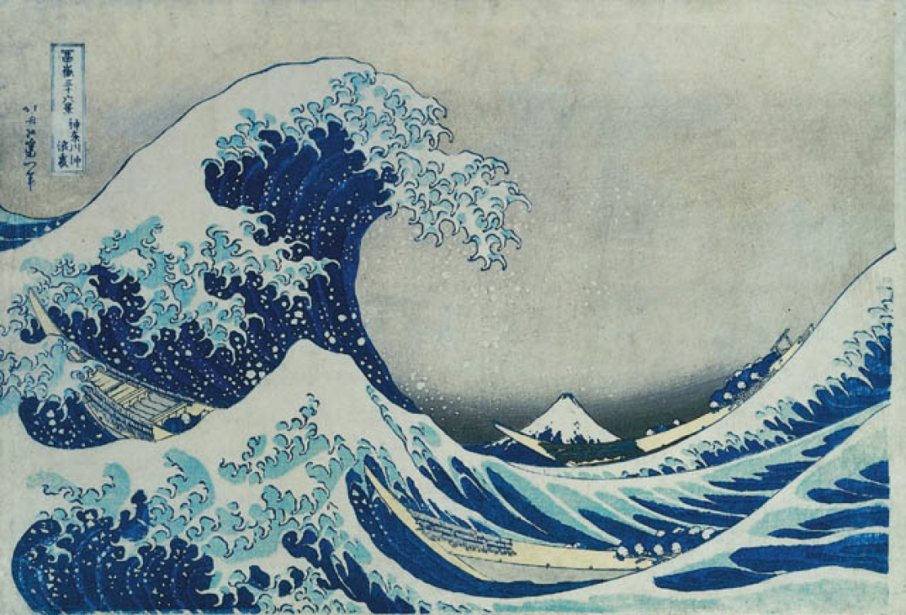
Mechanical Waves
Most waves must travel through matter
The matter through which a wave travels is
called the
medium.

Slide 4
Electromagnetic Waves
The one wave that does not need a medium.
Light waves are called electromagnetic waves

Slide 5
The terms light and light waves can refer to any type of electromagnetic wave – not just visible light

Slide 6
Waves & Energy
Waves carry energy
  They can do work
  They move objects

Slide 7
Waves & Vibrations
Most waves are caused by vibrations.
This vibration involves transformations of energy much like those in a swinging pendulum

Slide 8
As waves carry the energy, the particles in the medium move. The direction of this motion determines whether the wave is a transverse or a longitudinal (compressional) wave.

Slide 9
Transverse Waves
Waves in which the motion of the particles is perpendicular to the motion of the wave.

Slide 10
Transverse Waves
http://www.cleanvideosearch.com/media/action/yt/watch?videoId=UHcse1jJAto

Slide 11
Longitudinal Wave
Waves that cause the particles in a medium to travel parallel to the direction of the wave motion.

Slide 12
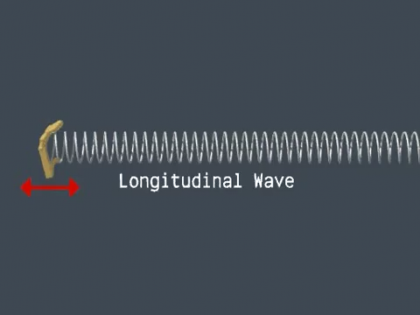
Longitudinal Wave

Slide 13
Transverse waves – water waves, electromagnetic waves
Longitudinal waves – sound waves, springs

Slide 14
Surface Waves:
A combination of transverse and longitudinal
Occur at the boundary of two mediums (ex – water and air)
The particles of a surface wave move both perpendicular and parallel to the direction that the wave travels.
Example on Page 503 in textbook

Slide 15
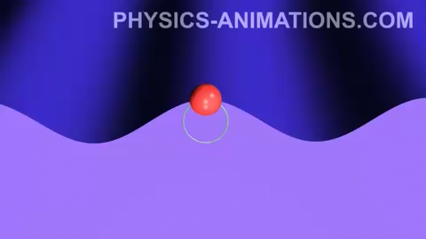
Surface Waves:
A combination of transverse and longitudinal

Slide 16
Review Questions
What do waves carry
Waves that travel through a medium are called ___.
Waves that do not need to travel through a medium are called ___.

Slide 17
Particles in a transverse wave travel ___ to the wave motion
Particles in a longitudinal wave travel __ to the wave motion
Particles in a surface wave travel ___ to the wave motion

Slide 18
Wave Properties
Amplitude
Wavelength
Period
Frequency
Wave speed

Slide 19
Crest & Trough
Crest – Highest point of a wave
Trough – lowest point of a wave.
Crest
Trough

Slide 20
Amplitude
The distance a wave moves from its resting position
Resting
position
Amplitude

Slide 21
Amplitude cont.
The larger the amplitude – the more energy is carried by the wave.

Slide 22
Wavelength
The distance from any point on one wave to a corresponding point on an adjacent wave.
Usually crest to crest or trough to trough
Wavelength

Slide 23
Wavelength cont.
The time it takes for one full wavelength of a wave to pass a certain point is called the period.
The symbol for wavelength is λ (the (Greek letter lambda)

Slide 24
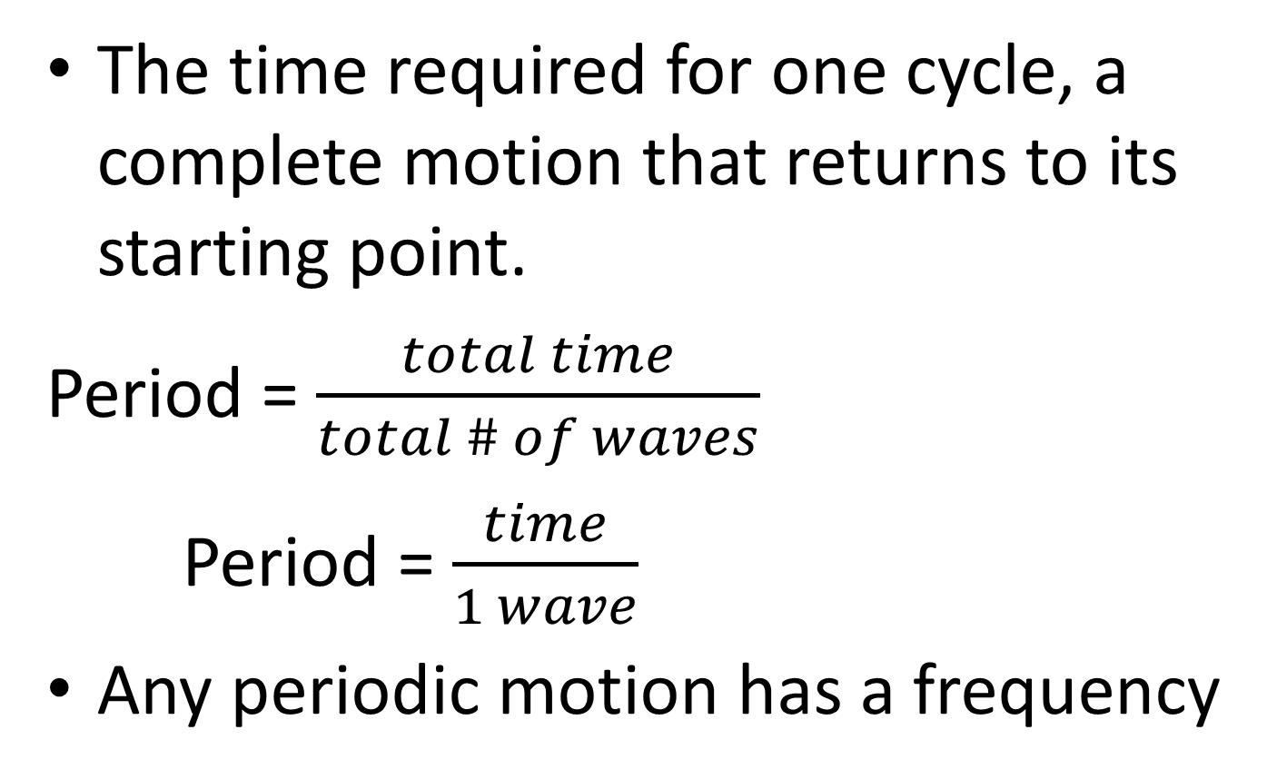
Period
The time required for one cycle, a complete motion that returns to its starting point.
Period = $\frac{total time}{total \# of waves}$
Period = $\frac{time}{1 wave}$
Any periodic motion has a frequency

Slide 25
Frequency
the number of full wavelengths that pass a point in a given time (rate).
The greater the number of waves per second,
  the higher the frequency
  the more energy carried by the wave.

Slide 26
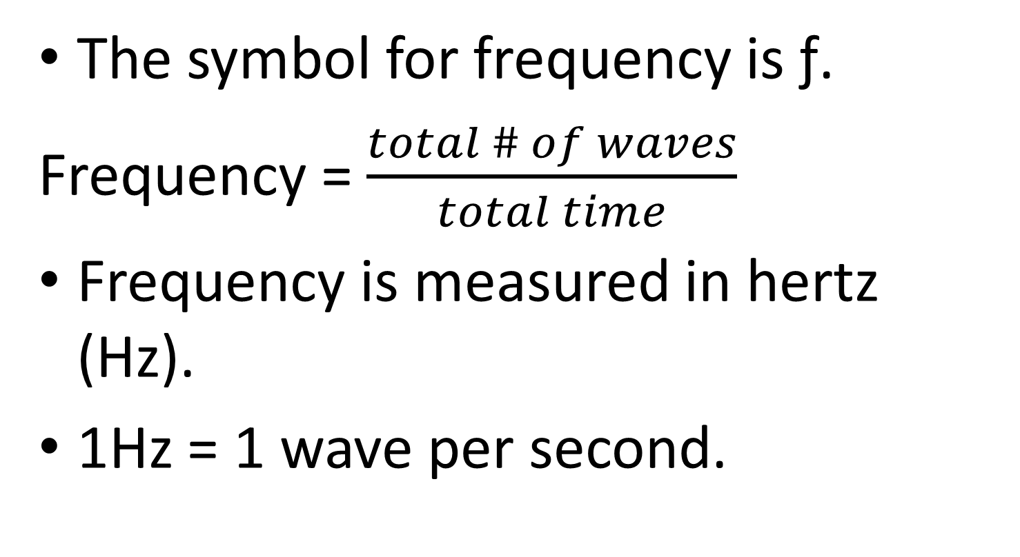
Frequency
The symbol for frequency is ƒ.
Frequency = $\frac{total \# of waves}{total time}$
Frequency is measured in hertz (Hz).
1Hz = 1 wave per second.

Slide 27
Wave Speed
How fast a wave
moves.
d
S = t
speed = frequency x wavelength
Speed = x =
or
v = f x λ
1 distance distance
time 1 time

Slide 28
Symbols and units
S = speed
  S unit is m/s
f = frequency
  f unit = Hz (or 1/s)
λ = wavelength
  λ unit = m (meter)

Slide 29
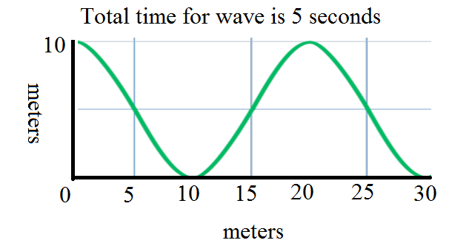
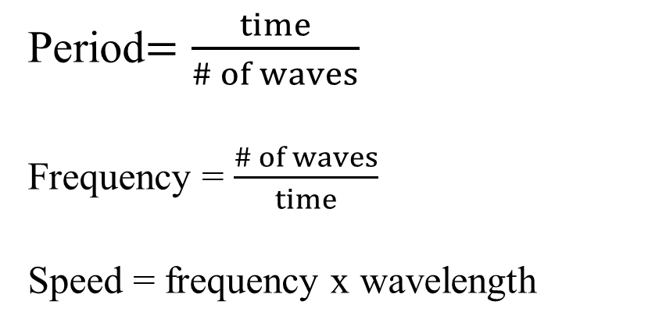
  Using the wave shown find
  Wave length
  The amplitude
  The period
  Frequency
  is crest to crest or trough to trough
  is rest to crest, or rest to trough
  is time for 1 complete wave
  is # of wavelength/total time
Period$=\frac{time}{\# of waves}$
Frequency = $\frac{\# of waves}{time}$
Speed = frequency x wavelength

Slide 30
  Wave length
  The amplitude
  The period
  Frequency
  Wave length =λ = 20 – 0 = 20 meters
  or λ = 30-10 = 20 meters
  Amplitude = A = 10/2 = 5 meters
  Period =P = 5 seconds for 1.5 waves = 5/1.5 = 3.33 s
  Frequency = f = 1.5/5s = 0.3 hertz
What is the speed of the wave?
Speed = wavelength x frequency
Speed = 20 m x 0.3 hz = 6 m/s
Example 1

Slide 31
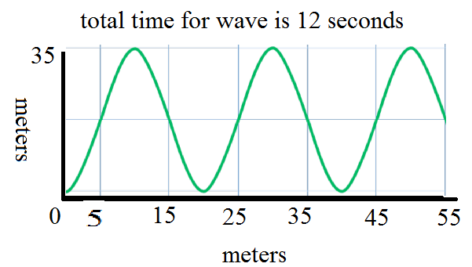
  Using the wave shown find
  Wave length
  The amplitude
  The period
  Frequency
  Speed
  λ= 20-0 = 20 m
  A = 35/2 = 17.5 m
  P = 2.75 waves in 12 seconds = 12/2.75 = 4.36 s
  f= 2.75/12s = 0.229 hertz
  s= 0.229 hz x 20 m = 4.58 m/s
Example 2

Slide 32
Wave Speed cont.
Wave speed depends on the medium.
In a given medium the speed of waves is constant.

Slide 33
Kinetic Theory and Wave Speed
In a solid, molecules are close together so waves travel very quickly through solids

Slide 34
In a liquid, molecules are farther apart but can slide past one another so waves do not travel as fast as in a solid.

Slide 35
In a gas, molecules are very far apart so a molecule has to travel far before it hits another molecule – so waves travel slow in gases.

Slide 36
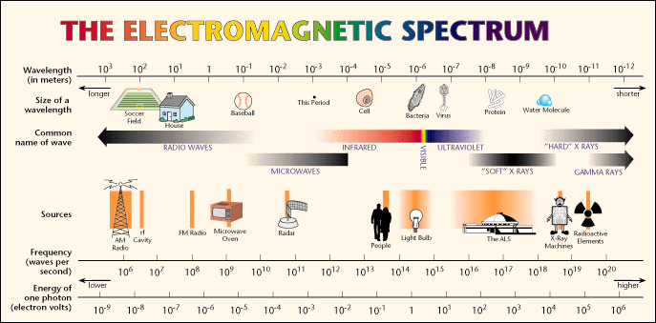
The full range of light

Slide 37
Light
All electromagnetic
waves in empty space travel at the same speed.
The speed of light is 3 x 10 m/s (or 186,000 miles per second)
The speed of light is constant.
8

Slide 38
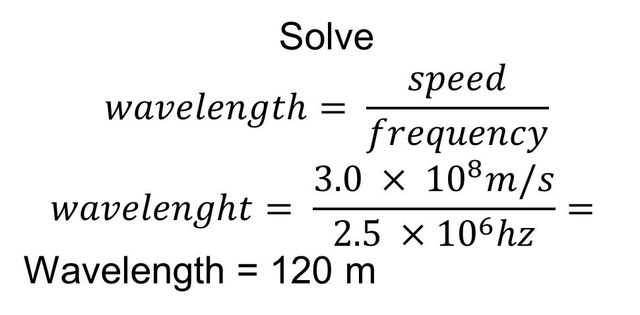
Example 3
A radio station has a frequency of 2.5 x 10⁶ hertz, if the speed of light is 3.0 x 10⁸ m/s what is the length of the radio wave?
Given
2.5 x 10⁶ hertz = frequency
3.0 x 10⁸ m/s = speed
?? = wavelength
Equation
Speed = frequency x wavelength
Solve
$$wavelength= \frac{speed}{frequency}$$
$$wavelenght= \frac{3.0 × {10}^{8}m/s}{2.5 ×{10}^{6}hz}=$$
Wavelength = 120 m

Slide 39
Doppler Effect
Pitch = how high or low a sound is determined by the frequency.
If an object making sound is moving – this changes the frequency with which your ear receives the sound.
Therefore the pitch changes

Slide 40
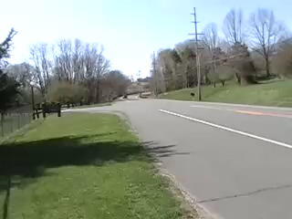
Doppler Effect

Slide 41
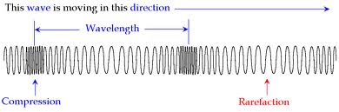
Parts of a Longitudinal Wave

Slide 42
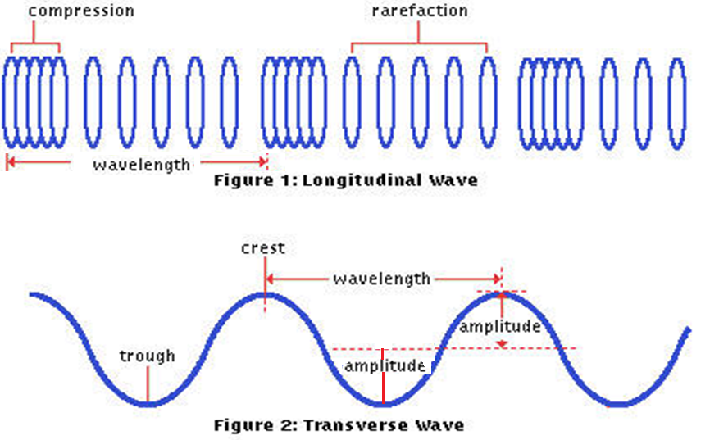
Wave parts summary

Slide 43
Review
What is amplitude?
What is wavelength?
How are frequency and period related?
What is the
symbol for
wavelength?

Slide 44
What is the formula for frequency?
What is the formula for wave speed?
What is the shortest wavelength on the electromagnetic spectrum?
What is the longest?

Slide 45
P. Sci.
Unit 5
Waves Interactions

Slide 46
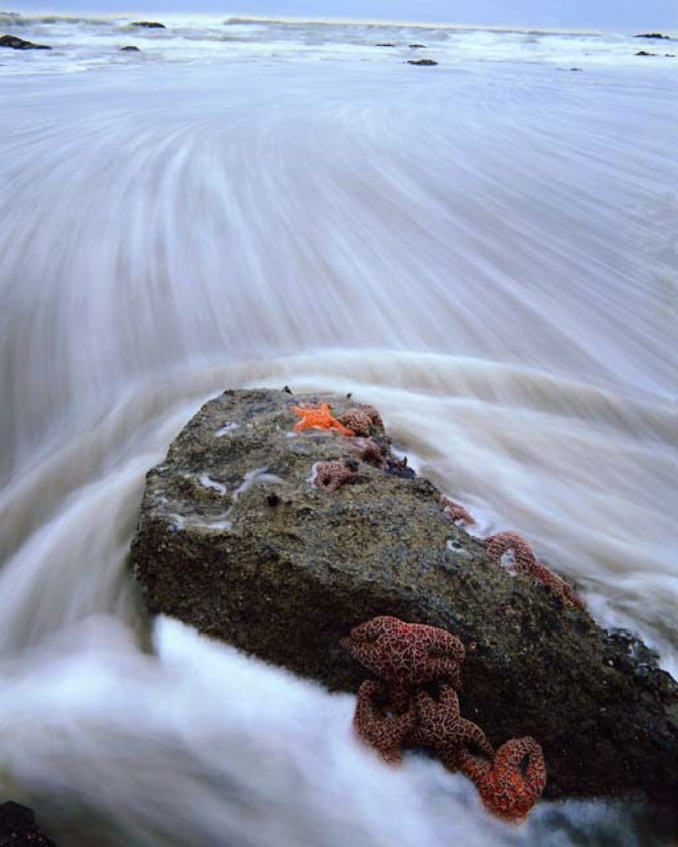
Wave Interactions
Interactions occur:
  when a wave meets an object or another wave.
  When a wave passes into another medium.

Slide 47
Reflection
The bouncing back of a wave when it meets a surface or boundary.

Slide 48

Reflection

Slide 49
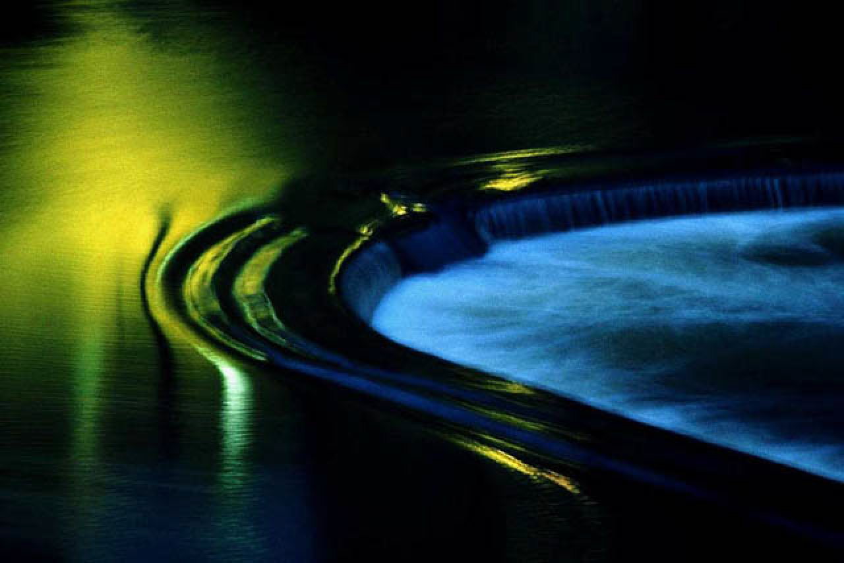
Diffraction
The bending of a wave as it passes an edge or an opening.

Slide 50
Diffraction

Slide 51
Refraction
The bending of a wave when it passes from one medium into another.

Slide 52
Refraction

Slide 53
Interference
When several waves are in the same location, the waves combine to produce a single, new wave.

Slide 54
Constructive interference – When the crest of one wave meets the crest of another wave – the amplitudes are added.
Destructive interference – when the crest of one wave meets the trough of another wave – the amplitudes are subtracted.

Slide 56
Standing Waves
The wave pattern that forms when waves equal in wavelength and amplitude – but are traveling in opposite directions – continuously interfere with each other.

Slide 57
The place where the two waves cancel each other are called “nodes” and these stay in the same place and the wave vibrates between the nodes. It looks like the wave is not moving

Slide 58
Resonance
The rapid amplification of a vibration when the vibrating object is subject to a force varying at its natural frequency (frequency at which a mechanical system will vibrate freely).

Slide 59
Resonance is how you tune a radio – you adjust the natural frequency of the receiver circuit until it coincides with the frequency of the radio waves falling on the aerial.

Slide 60
Waves and particles
The difference between them is not clear.
Light can behave as a particle, a photon, whose energy depends on frequency.
All particles can behave like a wave.

Slide 61
Review
What is it called when waves bounce off a surface?
What is the bending of
waves as they pass an
object.
When a wave bends as it passes from one medium to another it is called what?

Slide 62
What is it called when two waves exist in the same place and combine to make a single wave?
What happens to the amplitudes in constructive interference?
What happens to the amplitudes in destructive interference?

